Slide 1
CS 330 Case Study Part II
By Benjamin Schussheim, John Lee, Joey Nolan, Ezra Odio

Slide 2
Task 4 – Approach II Algorithm Overview
Take all the points from all trajectories and split them up into a list of batches “B = [b_1, …, b_k]”. Each batch “b_i” is a set of points. The following sub-algorithm computes “B”.
Initialize the variables “w”, “d”, and “Tau”. “w” is the window distance, “d” is the cutoff distance, and “Tau” is the set of all trajectories.
For each iteration “i” of the algorithm:
Increment “d += w”.
Iterate over each trajectory “T_j” in “Tau“, and transfer all points from “T_j” to the batch “b_i” where the following condition is met: the cumulative distance traveled by points in the trajectory up until this point is less than “d”.
Repeat until “Tau” is empty and all points have been transferred to “B”.
For each batch “b_i,” if it is not empty, compute “xbar_i” and “ybar_i”, the median x and y value of all the points in “b_i”. Create a new point with these values “pbar_i = (xbar_i, ybar_i)” and append “pbar_i” to the list of points that makes up the center trajectory “T_c”.
Return “T_c”

Slide 3
Task 4 – Approach II Runtime
The algorithm’s expected runtime is O(N + |B|*b*log(b)) where N is the total number of points in all trajectories, B is the number of batches, and b is the average size of each batch. However, N >> B and N >> b > log(b) so the |B|*b*log(b) term can be neglected and the runtime can be approximated as O(N).
The runtime is O(N + |B|*b*log(b)) because the algorithm only looks at each point once when computing “B” so the runtime of creating “B” is O(N). Then, when “pbar_i” is being computed from each batch “b_i”, all the points in “b_i” are sorted, which takes O(b*log(b)) time which is computed for each batch so the total runtime of sorting each batch is O(|B|*b*log(b)). This is a total of O(N + (|B|*b*log(b))).

Slide 4
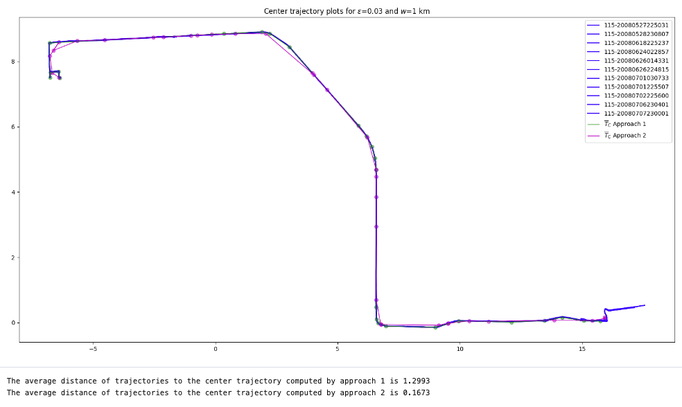
Task 4 – Experimental Results (1)

Slide 5
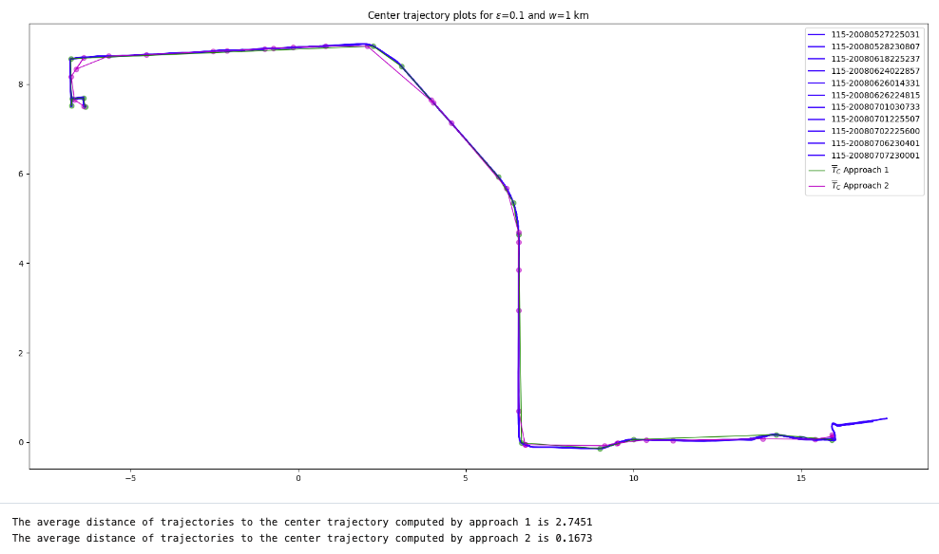
Task 4 – Experimental Results (2)

Slide 6
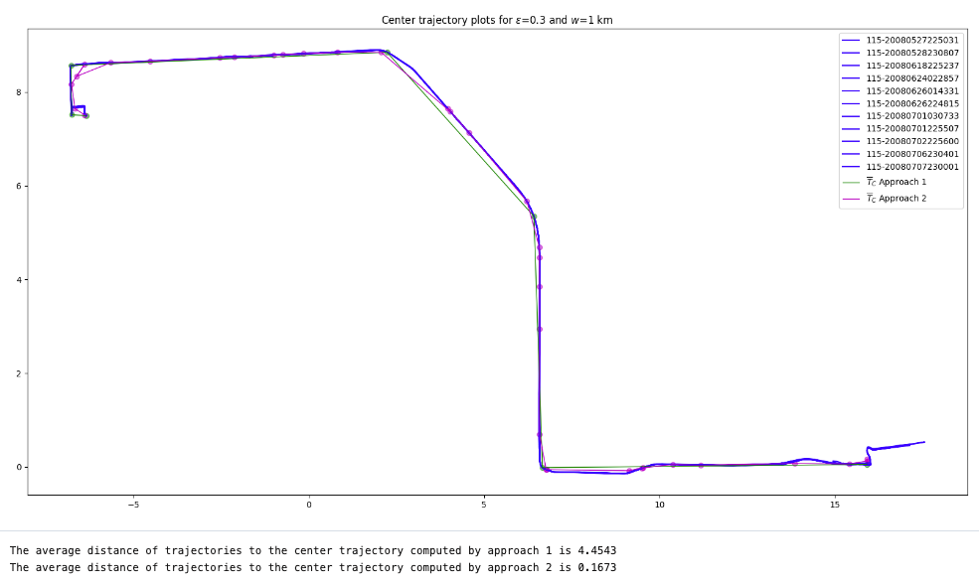
Task 4 – Experimental Results (3)

Slide 7
Task 4 – Comparing Approach II to Approach I
Strengths
Much more efficient runtime
Is not limited to returning an existing trajectory
Lower average distance than Approach I
Weaknesses
“w” is a hyperparameter that must be tuned. Too high causes the trajectory to backtrack and too low increases runtime
The algorithm is sensitive to the starting positions of each trajectory in “Tau”. If the trajectories begin at far apart locations then the accuracy decreases
If the size of batches are too large then O(|B|*b*log(b)) runtime term grows and the runtime slows down

Slide 8
Task 5 - Proposed Seeding Method
First, we choose one random trajectory to be a center. Next, we compute the distance from each trajectory to its closest center. We then take the trajectory that is the farthest (max) distance from a closest center, and choose this trajectory to be our next center. We then repeat the process of computing distances and choosing a new center until we have found k centers.

Slide 9
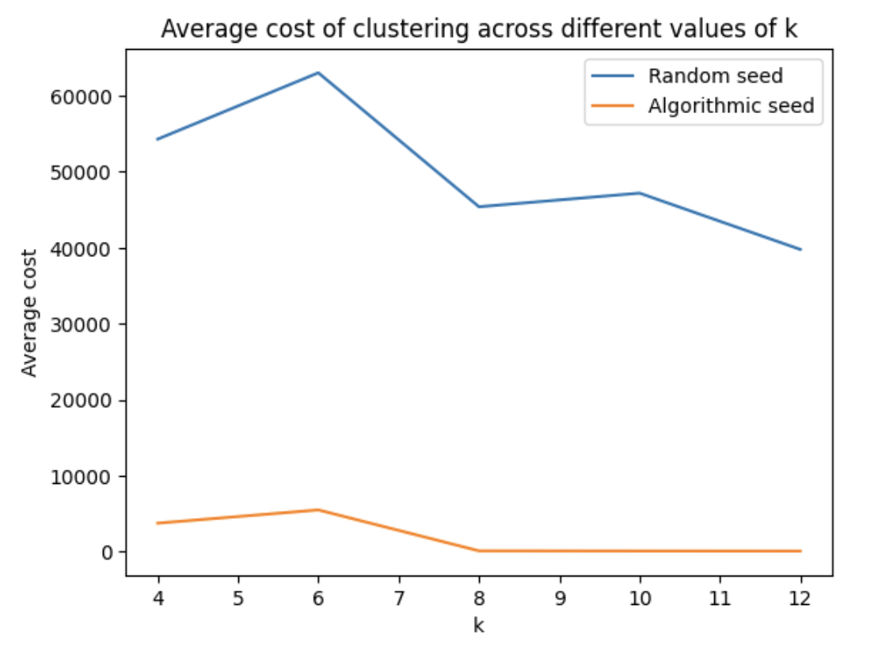
Task 5 - Cost-Analysis of Random vs. Proposed Seeding

Slide 10
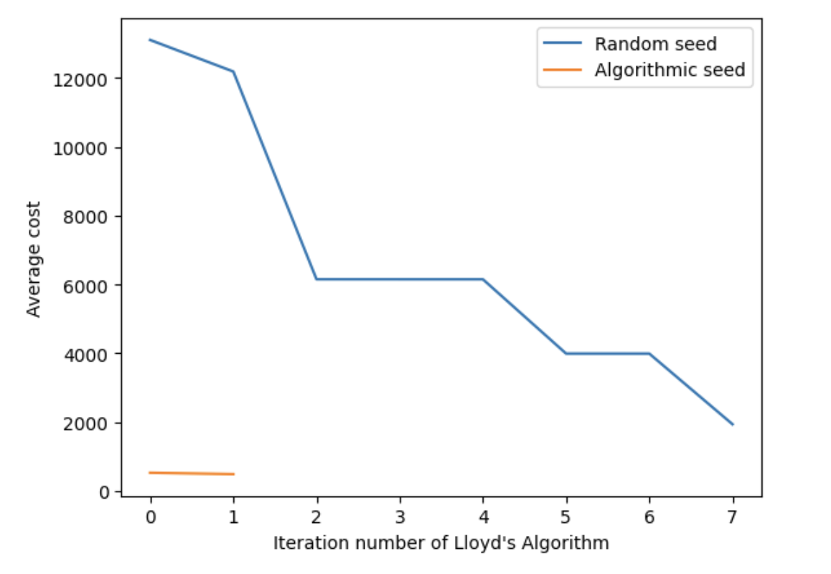
Task 5 - Cost of Clustering per Iteration

Slide 11
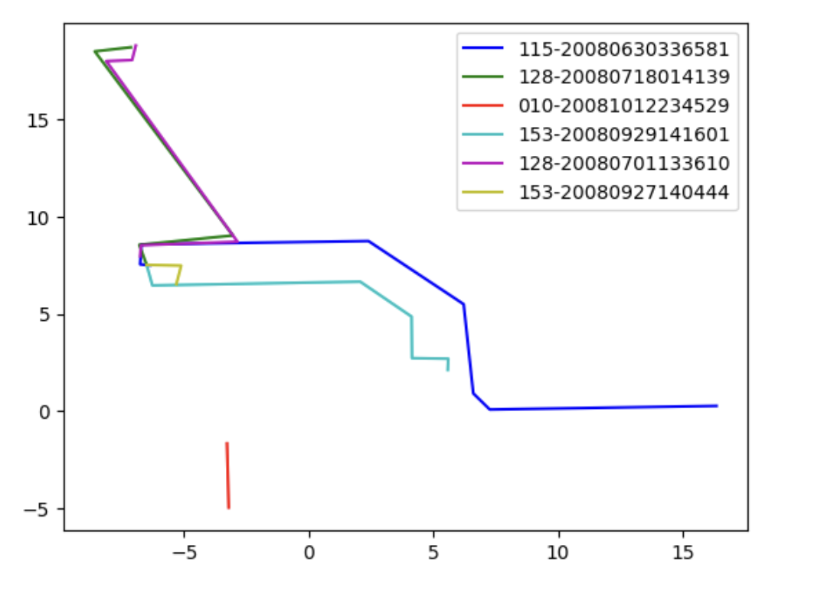
Task 5 - Plot of Center Trajectories

Slide 12
Advantages of Proposed Seeding Algorithm
The proposed seeding algorithm reduces the overall cost of the clusters partitioned. It also dramatically reduces the number of iterations Lloyd’s algorithm runs before terminating, thus improving the runtime of the algorithm.

Slide 13
Task 5 - Choosing the Number of Clusters
One way of choosing the number of clusters is by looking at the average cost between each trajectory and its center for each cluster. This will get smaller as the number of clusters increases, however at a point the marginal benefit of adding another cluster diminishes so much that adding the additional cluster does not provide more insight about what’s happening with the data. This point indicates the number of clusters that should be used to classify the data. This method for determining the optimal k-value is known as the elbow method.
For our dataset k=6 seemed an appropriate number of clusters. This was the point where the marginal benefit of adding another cluster became meaningful smaller most times we ran the code.

Slide 14
Task 5 - Alternate Approaches for Clustering Trajectories
An alternate approach that we could use for clustering trajectories is the k-medians algorithm. As its name suggests, k-medians is similar to the k-means algorithm, but uses median instead of mean. Because median is less sensitive to outliers than mean is, k-medians is less sensitive to outliers than k-means is. Depending on use case, we might opt for k-medians because of this difference.

Slide 15
Group Member Contributions
Benji: Task 4 algorithm, task 4 slides
Joey: Task 4 and task 5 algorithms
Ezra: Task 5 algorithms, task 5 slides
John: Task 5 Seeding Algo, Lloyd’s algorithm help

